Slide 1
Targeting Meta-awerness for internal atteition biases among ruminative individuals

Slide 2


Slide 3







“Are you following?”
MAB
MBTRR
A-FACT
STP-DCT N Back Dichotic
WT*?!
MAT

Slide 4
Overview
Aims:
Developing a novel brief mindfulness-meditation (BMM) training for internal attentional biases
Comparing AFACT, BMM and placebo training groups on the following measures :
Measures:
Quantifying internal attentional control
Quantifying Meta-awareness for internal attentional bias
Testing generalizability of training to internal attentional bias with internal demand
Population:
Students with heigh tendency towards negative repetitive thinking
Notes:
Attentional (dys)control is key to (mal)adaptive responding to both environmental (external) and metal (internal) events and demands

Slide 5

My target today:
Receiving a general feedback on the project
Receiving feedback on the novel training task (BMM)

Slide 6



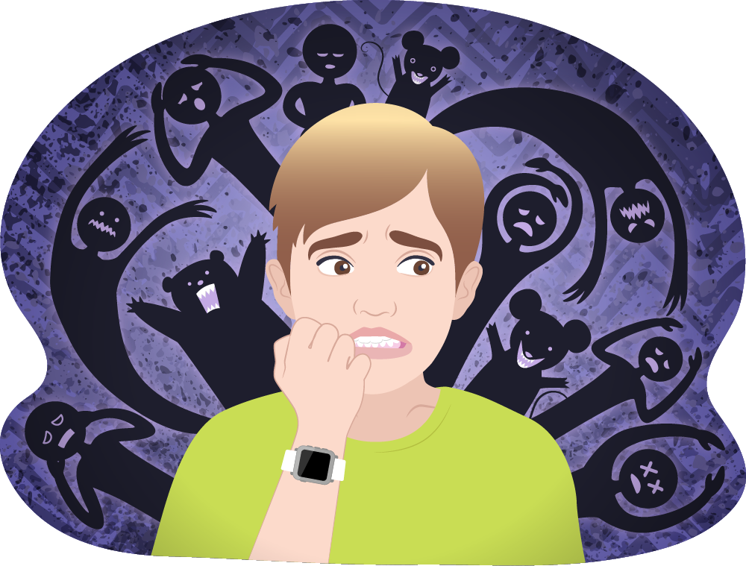
The role of Attention
Attentional biases – key aspect of mental (ill) health Ruimi, Amir, Hadash, Goldstein & Bernstein, submitted; Amir, Ruimi, & Bernstein, submitted; Ehring & Watkins, 2008; Goldin, Manber, Hakimi, Canli, & Gross, 2009;
For example :
Eating disorders
Anxiety disorders
Affective disorder
Substance abuse and addiction
PTSD
etc.
Notes:
Attentional (dys)control is key to (mal)adaptive responding to both environmental (external) and metal (internal) events and demands

Slide 7
How to ameliorate attentional biases?
Notes:
Attentional Bias Modification Training
(ABMT), the first (and only) attempt to-date to target attentional
biases specifically, has demonstrated modest effects.
Recent metaan-alyses demonstrate that even the short-term effects of ABMT
with respect to anxiety reduction are modest bias reduction conditioned with In one paradigm (e.g.,dot-probe) may
not generalize to other paradigms (e.g., visual search). and some recent efforts
to replicate ABMT findings have failed

Slide 8

Training Meta-Awareness

Slide 9
■ meta-awareness and attentional control
The function of Meta-Awareness
Serves for self monitoring that consequently enables
Regulation and control for – behavior (e. g. response inhibition) and emotion (e. g. reactivity) ¹
EMPIRICAL FINDINGS: Quantifying Meta-Awareness for bias
A study conducted in the lab showed a clear and robust association between the existence of meta-awareness for bias towards emotional stimuli and subsequent attentional control ²
Bernstein & Zvielli, 2014; Creswell, 2016
Ruimi, Hadash, Zvielli, Amir, Goldstein & Bernstein, 2018

Slide 10
Attempts to target and train meta-Awareness
Real time feedback on attentional bias towards emotional stimuli
AFACT studies (Ruimi, Hendren, Zvielli, Amir, & Bernstein, 2020; Bernstein & Zvielli, 2014; Zvielli, Amir, Goldstein, & Bernstein, 2016)
Found to positively influence:
Meta-awareness of biased external attention
External attentional control
(to reduce) emotional reactivity to an anxiogenic stressor
Mindfulness/meditation-based interventions
Meta-awareness is a central target and key mechanism of action of mindfulness training (Bernstein, Hadash, Lichtash, Tanay, Shepherd, & Fresco, et al., 2015; Dunne, Thompson, & Schooler, 2019)
Found to positively influence:
sustained attention
attentional selection
attentional control
Ruimi et al., Submitted
Notes:
Attention Feedback Awareness and Control Training (A-FACT; Bernstein & Zvielli, 2014) was designed to train meta-awareness of, and thereby greater self-regulatory control over, attentional processing of emotional information. To do so, A-FACT delivers personalized real-time feedback on moment-to-moment expressions of (biased) attention as measured from trial-to-trial via cognitive-experimental tasks
elevated levels of meta-awareness of biased external attention and thereby greater external attentional control ()
greater control over covert as well as overt external attentional processing of threat and reward

Slide 11
Gaps and problems
Real-time feedback literature – focus on external attention
Mindfulness based training literature:
Effects are either not consistent, or of small magnitude
Meta-awareness was not quantified directly
Notes:
Why internal attention is more/as important to focus – just because little is known?

Slide 12
Current research
Focuses on internal attention biases and control
Quantifies meta-awareness for internal attentional biases
compares two intervention types
Mindfulness based/ real time feedback for bias
Criteria:
Change in internal attentional control
Post intervention meta-awareness for internal attentional biases
Generalizability to other domains of – internal-internal

Slide 13
Method
STP
DCT
AFACT/BMM
MAB
Dichotic one-back
Notes:
Attentional (dys)control is key to (mal)adaptive responding to both environmental (external) and metal (internal) events and demands

Slide 14





stp
STP Stimuli Selection and Mental Health Related Questionnaires
Participants review 100 self-referential sentences and rate each sentence on its frequency and emotional valence. Participants also complete a battery of mental health related questionnaires.
STP Stimuli Recording
Participants are recorded speaking idiographically selected unique subset of emotionally negative and emotionally neutral self-referential sentences.
Schema Activation
Participants rate their subjective positive and negative affect before and then after listening to their own simulated-thought stimuli.
Attentional (dys)regulation task
STP stimuli are presented as part of a digit categorization task¹ or dichotic 1-back task.
*Figure taken from Amir, Ruimi & Berentein, under-review

Slide 15
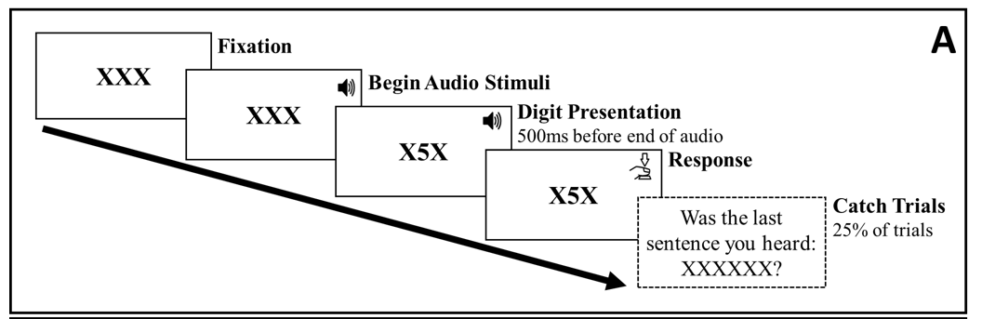
Stp-dct
*Figure taken from Amir, Ruimi & Berentein, under-review

Slide 16
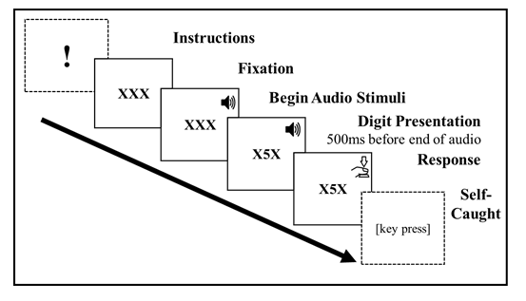

MAB
Notes:
The Self-Caught Meta-Awareness task integrated in the Digit Categorization Task. After participants receive instructions regarding the self-caught procedure, each trial begins with three Xs (horizontally aligned) presented at the center of the screen. After 1000 ms, participants hear an auditory negative self-referential or neutral self-referential sentence. Five-hundred ms before the end of the auditory stimulus the central X is replaced by a single visual target stimulus digit number (from 1 to 8) until response. Participants are instructed to press one of two keys categorizing the target digit as odd or even. After response to the target digit, participants spontaneously reported (by pressing a correspondent key) whether negative self-referential thought (during the last trial) influenced their response on that trial.

Slide 17
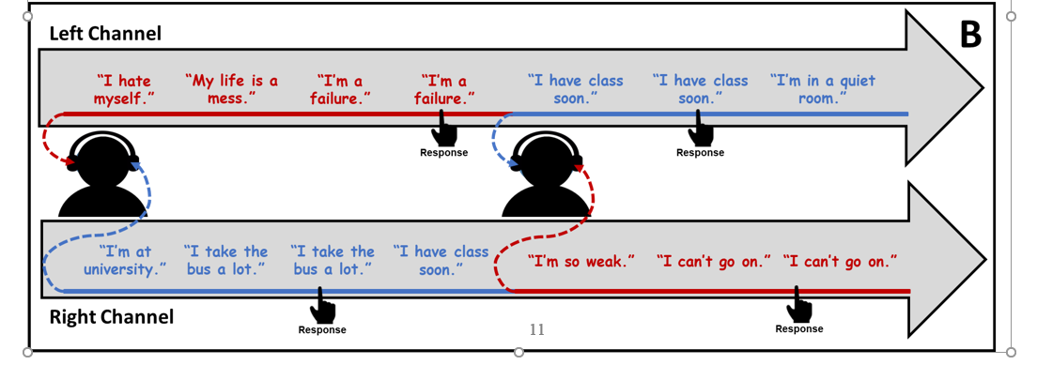
Dichotic One back
*Figure taken from Amir, Ruimi & Berentein, under-review
Notes:
Participants hear two separate lists of auditory stimuli, one list in each channel (ear). Stimuli lists are randomly mixed into intra-block sequences (i.e., 12 STP stimuli/sequence) of negative and neutral self-referential thoughts. When one channel (e.g., left side) delivers a negative stimulus the opposite channel (i.e., right side) delivers a neutral stimulus. At pseudo-random intervals, the simulated thought stimulus in one of the channels is presented sequentially (i.e., specific STP recording is repeated). Participants are asked to, as accurately and quickly as possible, press one of two buttons corresponding to the channel (LEFT/RIGHT) in which the stimulus was repeated sequentially. Biased selective internal attention is computed by subtracting accuracy in responding to repetitions in neutral stimuli from accuracy in negative stimuli. A positive bias score reflects greater selective attention to negative vs. concurrent neutral stimuli.

Slide 18

Internal A-fact
Instructions
!
XXX
Fixation
XXX
Begin Audio Stimuli
Digit Presentation
500ms before end of audio
XXX
XXX
Response
Feedback

Slide 19
Dealing with past problem
In the latest training-control experiment we observed a sort of celling effect in improvement
The current study took the following measures
Reducing number of trials in all tasks
Allocating STP stimuli such that each task has its share of unique (first heard sentences)
Changing the Digit-Categorization task during A-FACT to Quantity-Categorization
4

Slide 20
Home
Questionnaires Battery
(RRS\PTQ\ER\ DAADS)
80 trials:
40 (-)
40 (~)
15 unique + 5 from DCT pre - 2 repetition
(personalized)
(also a measure)
30 trials:
15 (-)
15 (+)
5 unique +
5 DCT post
+ 5 training
– 1
repetition
80 trials:
80 (-)
80 (+)
10 unique + 10 (form training) – 4
repetition
STP Recoding
(audio editing)
20 trials:
10 (-)
10 (+)
5 unique – 2 repetition
20 trials:
10 (-)
10 (+)
5 unique – 2 repetition
LAB
STP – AFACT – (other similar task
Response and stimuli)
(Training)
AFACT
STP - DCT
(Baseline of bias)
STP – MAB
ONE BACK DICHOTIC
STP
STP – DCT
(post-interv)
BMM
STP - DCT
(Baseline of bias)
BMM
(Training)
STP – DCT
(post-interv)
STP – MAB
ONE BACK DICHOTIC
STP
Control
STP - DCT
(Baseline of bias)
STP-DCT
(placebo)
STP – DCT
(post-interv)
STP – MAB
ONE BACK DICHOTIC
STP

Slide 21

BMM

Slide 22
BMM - questions
General task feedback?
Should task length or number of STP stimuli be kept equal to A-FACT?
Button presses dependent task progression?
Are the current self noting instructions enough?

